Slide 1
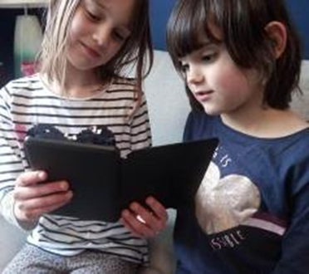
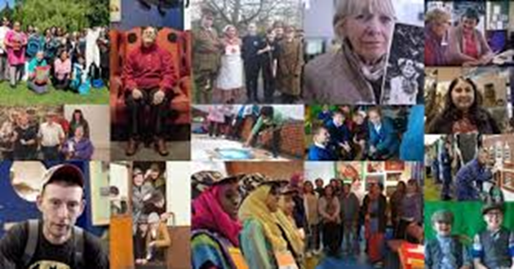
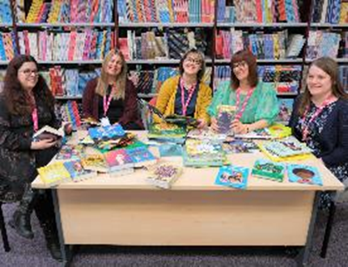
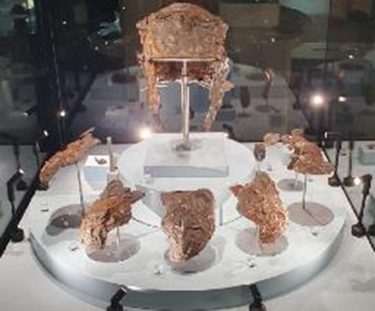
Creating Space to Spark Imagination, Celebrate Communities and Enhance Wellbeing

Slide 2
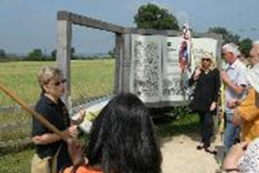
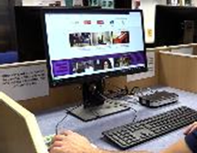
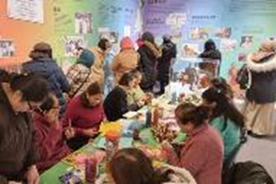
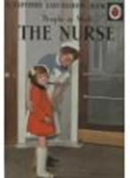
Our Library, Collections and Learning, Heritage and Cultural Participation services come together as
Culture Leicestershire.
Together we deliver a diverse, inclusive, accessible and engaging cultural offer with a focus on health and wellbeing, building great communities, improving opportunities and helping to build a strong local economy.
We are a National Portfolio Organisation (NPO), supporting the delivery of the
County Council’s strategic outcomes and Arts Council England’s Let’s Create strategy.
Our new shared vision is to
Create space to spark imagination, celebrate communities and enhance wellbeing

Slide 3
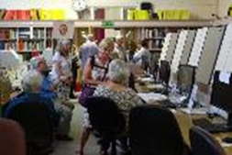
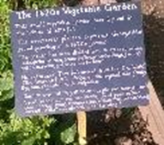
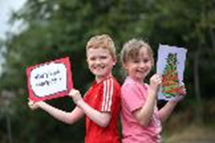
Great Communities - Libraries
The 2022-2025 mission for the library service is to provide Family Friendly Spaces to encourage all children to fulfil their potential.
To achieve this ambition a programme to improve spaces in libraries utilising Section 106 developer contributions was created
We support a network of 34 Community Managed Libraries (CMLs) the majority are entirely volunteer run. Collectively they provide nearly 600 hours of access to library venues per week.

Slide 4
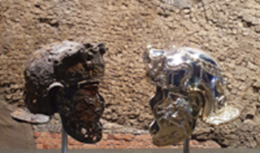
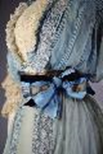
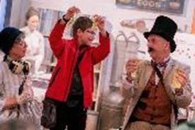
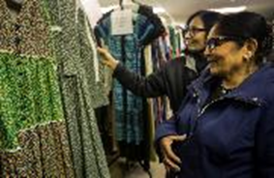
Great Communities
Museums and Heritage
Harborough Museum revealed new displays making the silver gilt first century Roman Cavalry Helmet the centrepiece of the Hallaton Treasure gallery.
All five Heritage sites delivered a diverse and popular events and activities programme. This included living history camps, guided walks, trails, talks, family activities, fairs and workshops for all ages.

Slide 5
Great Communities – Museum Collections
The World Cultures collection forms part of the historic museum education school loans service which dates back to the 1930s and is now curated and cared for by the Museum Collections Team.
“We enjoy volunteering at the Collections Centre as we have the opportunity to make improvements and preserve the collection for the future. We are able to check for infestations, do photography, catalogue and re-pack – and enjoying the opportunity to handle rare and historic items and learn more about their origins”
Jill and Sue – Collections Conservation Volunteers

Slide 6
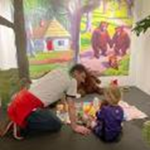
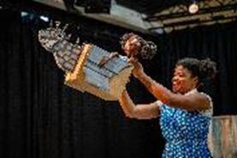
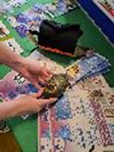
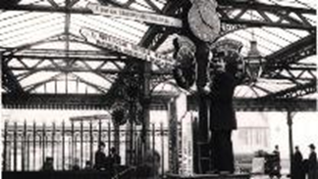
Great Communities – Community Curators
Over 500 people from the Harborough district shared their memories, experiences, meaningful objects and stories in an exhibition called We Are Harborough. Ukrainians and their host families, our Gypsy and Traveller communities, young people, adult learners, children and their families and heritage volunteers collaborated and worked together to showcase what Harborough means to them.
“When the bombs started dropping, we had to leave our homes in a hurry, often with only half an hour to get out of our house, taking with us the bare essentials to get to the bomb shelters in underground stations. Some of us stayed in the shelters for days. When a period of relative quiet came, if it was safe, we would go back to our homes to get more supplies. Some of us never had the opportunity to return to our homes before we had to flee our country. This exhibition showcases the most precious or meaningful objects we brought with us to England. This has helped us to tell our story and made us feel more at home here”.
“We are doing this exhibition to share that we’re the same as you, we just have a different lifestyle.”
“People seem to fear us, but nothing to fear, we suffer from generalisations”.
“Our lifestyle might be different, but we are equal.”

Slide 7
Great Communities/Safe and Well
The Friends’ Welcome
A 1620s House staff, Friends and Participation team Initiative
Based on a survey of 365 local residents
Provides free weekly activities, games, crafting, coffee, chatting and socialising.
A wellbeing expert provides advice and help, including signposting
Supports volunteers with training, resources
Additional Parish Council funding has now been secured
“Getting out of the house and mixing with people. It helps my mental health as I have anxiety.”
“I feel proud to be part of the team that makes this happen. Knowing I can make a difference… makes me happy.”

Slide 8
Safe and Well - Libraries
Family Hubs
A service that gives families simple easy access to advice, information, resources and support
Libraries are ‘spokes’ of the Family Hub programme
Signpost and guide people to the main Family Hubs Service.
The Family Hubs have worked with libraries to deliver ‘Making Every Contact Count’ training to staff
Provides resources in Libraries that can improve family wellbeing and opportunities.
Impact of libraries
Families find our libraries safe spaces, free from some of the stigma associated with more formal social service settings.

Slide 9
Safe and Well – Chilled Charnwood
Bespoke offer for children and families with additional and special educational needs.
MDEM Covid Recovery Grant by the Participation Team
Creative Learning Services and museum partnership
Monthly quiet opening - a safe and relaxed space for families, including:
reduced sound levels, ear defenders and raised light levels
fidget backpacks and a new quiet Chill Out Zone
museum collections for handling and sensory resources
Staff training
Together, we developed:
A social story in partnership with Loughborough Adult Learners Heritage Group
A sensory map of the museum

Slide 10
Safe and Well - Home Library Service
Volunteer service delivering books to adults in their own homes
Targets people experiencing ill health, caring responsibilities or incapacity
Clients matched with a regular volunteer
Clients and volunteers form supportive befriending relationships that eases isolation
Great mental health benefits for both clients and volunteers
Achievements and impact this year:
Appointment of a full time Home library Service Officer role
48% increase in clients, 64% increase in volunteers
”The service has been a great help to me … people like my volunteer make a big difference to people like me.”

Slide 11
Improved Opportunities - Libraries
The theme for the 2023 Summer Reading Challenge was ‘Ready, Set, Read’, a major national campaign co-ordinated by The Reading Agency.
Nearly two thousand more children took part in the challenge than last year, reading an incredible 252,035 books and reading or listening to 2,644 e-books!

Slide 12
Improved Opportunities
Creative Expressions in Libraries
Developing cultural opportunities for children, young people and families using our network of libraries has been a key priority this year. Our Creative Expression In Libraries (CEIL) programme offered participants a rich experience of working in partnership with highly skilled creative practitioners.
In many cases the impact of the work has been profound with one young man returning to college
to pursue a qualification in photography specifically because of his involvement in the project at Melton. “It has given him a purpose for moving on.”
More generally over 85% of those involved in projects reported their intention to engage further with future cultural activities in libraries and noting feeling more connected with their local library.

Slide 13
Improved Opportunities
Creative Learning Services
Creative Learning Services (CLS) provide learning opportunities for young people across all key stages giving them access to inspiring collections and supporting all learning needs and abilities.
“Many teachers were surprised how well their classes engaged and there were comments about how powerful it was to hear someone talking passionately about books”.
The CLS collections give young people access to original works of art and museum collections in their own classrooms.
“Adults in the session were pleasantly surprised that children who wouldn’t usually engage with new adults had their hands up to answer questions. These are children with high needs. That shows how comfortable they were in the session and how engaged they were. The whole class accessed the learning and had a great time. I will be asking for this session again next year”.

Slide 14
Stronger Economy
ROLLR & Museum Collections
Supply of skilled and qualified people meets the demands of the workforce.
Our Engaging Collections Programme uses our museum collections to inspire creativity, encourage research and develop skills needed within the creative economy. By encouraging students, lecturers and researchers to use this rich resource, our collections inspire the designers of the future and inform those studying the past.
Record Office researchers and search room users include those who are engaged in under-graduate and post-graduate study, developing valuable research skills and gaining and sharing knowledge.

Slide 15
Stronger Economy
Creative Economy and Tourism
Our Arts Council funding enabled us to create 20 opportunities for free-lance creative practitioners who use their skills as artists, musicians, actors, writers, performers, makers and producers to develop co-created projects with our audiences.
Our museum and heritage sites are important to the local tourism economy and are recognised through the VisitEngland Visitor Attractions Quality Assurance Scheme (VAQAS). Sites are judged on the pre-arrival information, the arrival, quality of the attraction, the staff, site cleanliness, catering and retail offer. All our sites improved their scores in 2023.
Melton Carnegie Museum, Bosworth Battlefield Heritage Centre and the 1620s House and Garden have all now reached the gold standard and are nominated for VisitEngland’s prestigious Gold accolade which demonstrates an exceptional visitor experience.

Slide 16
Clean and Green – Environmental Responsibility
The Museum Natural Life collections are a historical and genetic record of the natural history of Leicestershire preserved for future generations.
At the 1620s House and Garden we are reducing our carbon footprint and encouraging visitors to learn about the environment and nature.
Culture Nature at Coalville Library received funding from Natural England and Libraries Connected and with the aim of developing a plan for a community ‘green space’ at the front of the library, to make the space more inviting and to use it as a catalyst for nature based cultural activities within the library.

Slide 17
Clean and Green – Environmental Responsibility
Cultural Youth Forum
We launched a new Cultural Youth Forum (CYF) to support our work with young people, enhance the development of our services and nurture the museum and library professionals of the future.
Over 60 young people engaged with over 20 workshops in our Market Town Museums
“This work will support young people from our county to help understand, shape and drive the council’s net zero ambition through taking action to cut carbon emissions, reduce their consumption of resources and protect nature.
It’s clear those involved are passionate about single use plastic, reducing fast fashion and reducing energy consumption and they have shared some creative ideas for example, increasing the vegetarian options in schools, reducing time in the shower and fully turning off devices rather than leaving them on standby.
Their activities across our Museums and Libraries has been seen by 1000’s of visitors which can only help raise awareness in ways that work for other young people. “
Jenny Allen. Team Manager. Carbon Reduction
https://www.cultureleicestershire.co.uk/films/

Slide 18
Creating Space to Spark Imagination, Celebrate Communities and Enhance Wellbeing

Slide 20
Achievements And Awards
The Record Office for Leicestershire, Leicester and Rutland has retained its Accredited Archive Service Status awarded by The National Archives (TNA).
The Heritage Education Trust’s Sandford Award 2023 was awarded to Bosworth Battlefield
East Midlands Heritage Awards
New Directions in Heritage – Foxton Canal Museum – Home is Where We Are!
Supporting Heritage – Medfest Community Panel
Best Project under £1000 – 1620s Garden Volunteers
Heritage Hero – Anila Sisoda
Archives & Research Entries – Loughborough Library Local Studies Volunteer Group ‘Market 800’
Hinckley and Bosworth Make a Difference Awards - Heritage Culture and Tourism Offer - in recognition of Hijaz for A Tale of Two Re-interments and the Med Fest Community Panel.

