Slide 1
Creating space to spark imagination,
celebrate communities and enhance wellbeing

Slide 3
Explore the power of harnessing our Sense of Place.
This session will focus on the opportunity and potential for development of activities that can reflect, celebrate and share the unique characteristics, heritage, culture and environment where you are!
Be inspired to connect your offer more closely to your local communities in new ways.

Slide 4
Today’s session
09.30 Welcome and what do we mean by Sense Of Place?
09.40 Introductions
09.50 Case studies - Nicola Levin, Helen Murray, Esther Shaw, Pippa Vidal Davies
10.30 Reflection
10.35 Q&A with presenters
10.50 Break
11.05 Group work- Your positive experiences with SOP work. What has worked well?
11.20 The role of the curator around SOP. Alison Clague / Q&A
11.40 Museums, SOP and tourism, Catherine Rogers/ Q&A
12.00 Overcoming challenges – group whiteboard exercise
12.15 Take-aways
12.30 Close

Slide 5
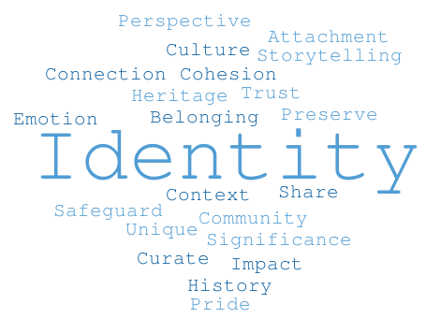

Slide 7
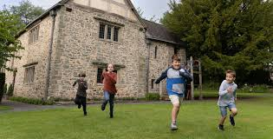
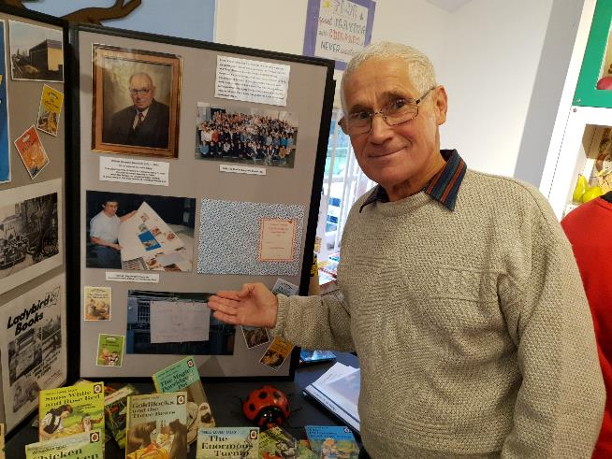
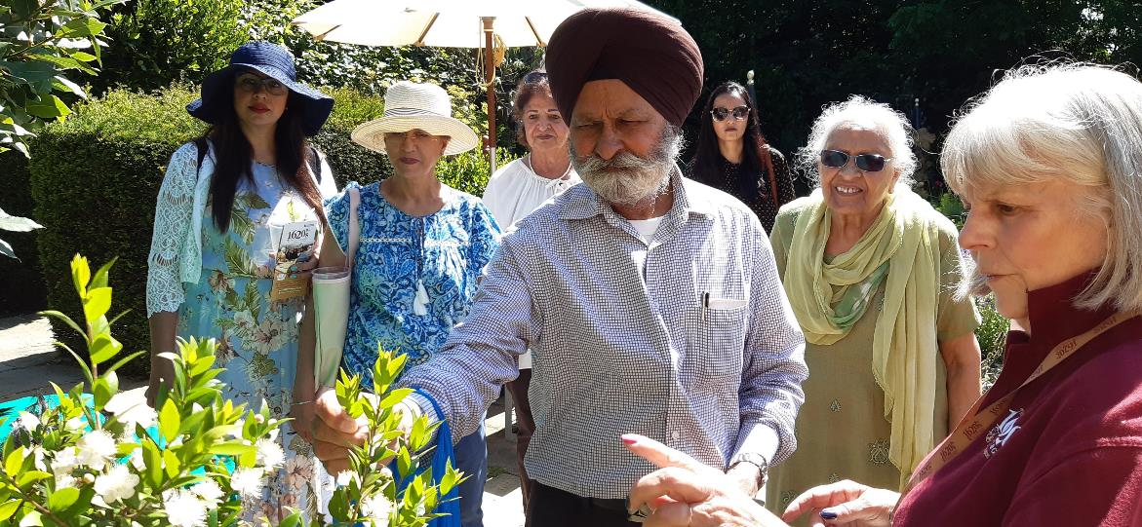
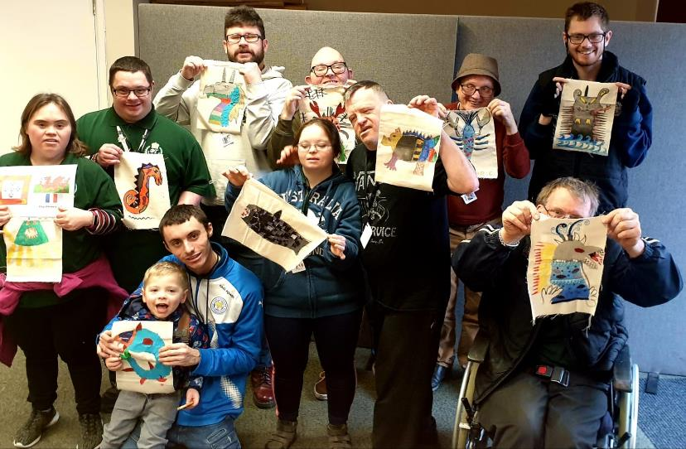

Slide 8
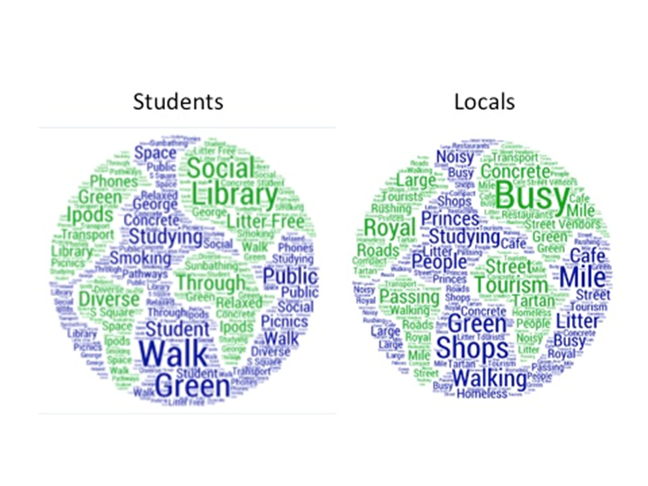
Sense of Place. Edinburgh

Slide 10
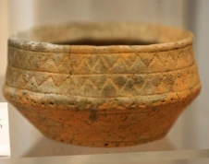
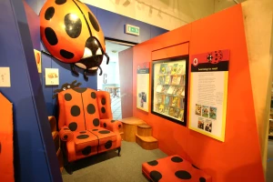
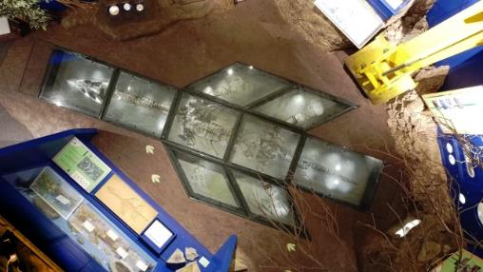
Introducing Charnwood
Charnwood is a borough in North-West Leicestershire. Its main town is Loughborough
Varied geographical make up that includes rural landscapes, urban area and historical villages
800+ year old Market town. The town played a key role in hosiery and lace-making industries during industrial revolution
Population: 184,000 people. Large Asian community representing 12.4% of the population of the area
Charnwood Museum- situated in Loughborough town
Showcases the rich heritage of the local area
Features a wide range of exhibits reflecting the history, geology, archaeology and industries of Charnwood and the surrounding area, permanent displays include 'Coming to Charnwood', 'The Natural World of Charnwood', 'Living off the Land' and 'Earning a Living’.

Slide 11
Do You See What I See?
-Held a series of workshops over a 10-month period which explored what heritage means to them in relation to their own identity, experiences and perspectives.
- Invited targeted community groups - including homeless and vulnerable people from the Falcon Centre, the Anand Mangal South Asian women’s group, a Polish community group and members of an independent living group for men from black and minority ethnic backgrounds.
- They were given time to explore our displays and were asked to choose just one object or exhibition that made them ‘stop in their tracks’ and share their connection to it

Slide 12
New Labels
“We used similar clay pots to store water in when I lived in India and Africa. We can also cook in them”
“I chose the power loom because my country has many power loom factories and make different kinds of cloth so I feel happy and interested in this past memory.”
“Many things reminded me of my working- class heritage: millworkers, miners, factory workers and how essential workers were (are?) to provide essential items for the country.”

Slide 13
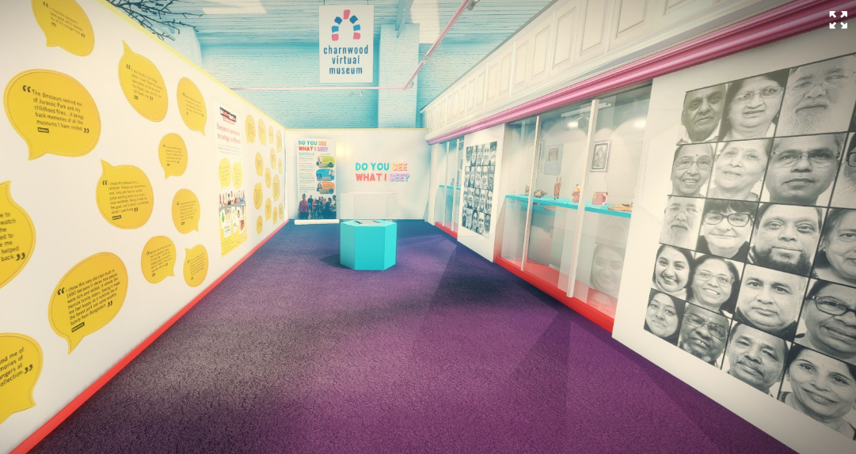
The Peoples Gallery
Participants were then asked to bring in their own object and share their story and connection to it
https://www.cultureleicestershire.co.uk/virtual-exhibitions/peoples-gallery/
An exhibition was co-created by participants who took the role of Community curators.
https://digital.onetoonedevelopment.org/charnwood-do-you-see-what-i-see/

Slide 14
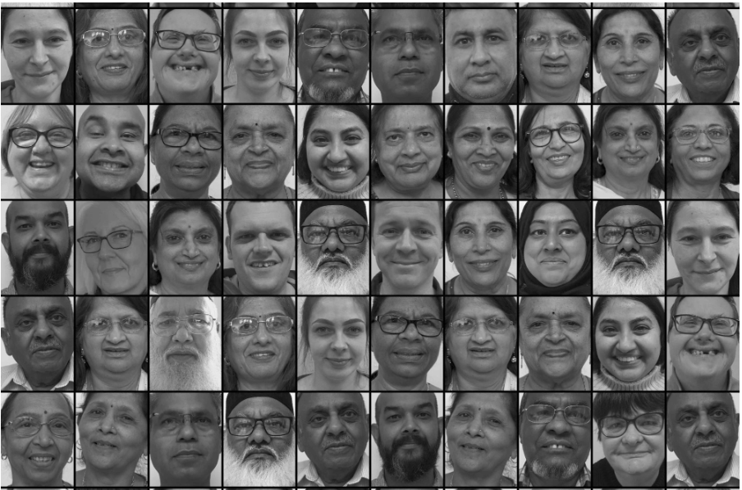
A sense of place
Creating a personal connection to local heritage
Celebrating diverse perspectives
Connecting the past with the present
Promoting community cohesion
Building a shared community identity
Fostering a sense of ownership
….building a sense of place

Slide 15
“You gave value to our culture and traditions. We are living in a multicultural society, so you have to give value to all cultures. I feel very happy that I was able to explain my feelings. I feel good that I was valued”- Mohammed
“In being different the heritage brought us together and I am very proud of it. Because of the museum project we understand each other better”- Anila
“I feel part of a better closer community now. I feel recognised” – Usher
“It was an amazing adventure; I gained new experience as a Pole in working between English and other nationalities…this project had something of a family approach to humanity. We became one global family, it was not the language, the colour or the origin that mattered. The DYSWIS project allowed us to look at objects from an individual point of view…I felt accepted by this country and its people. It is difficult for a Pole to exist in a foreign land, and here is such a blessing. I am very happy with this success, and I think this is just the beginning.” – Jola

Slide 16
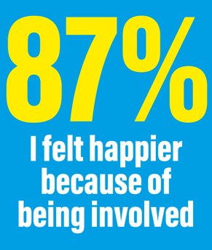

Slide 17
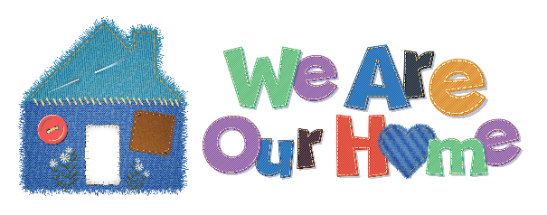
Introducing Harborough
We Are Harborough
We Are Our Home
Harborough at Work
Home is Where We Are

Slide 18
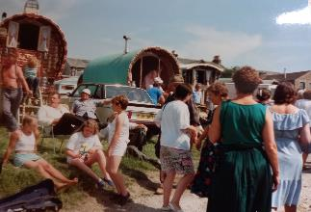
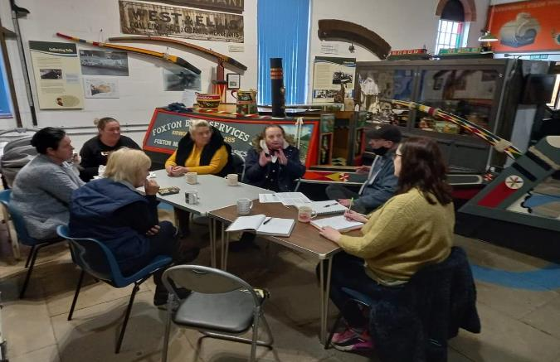
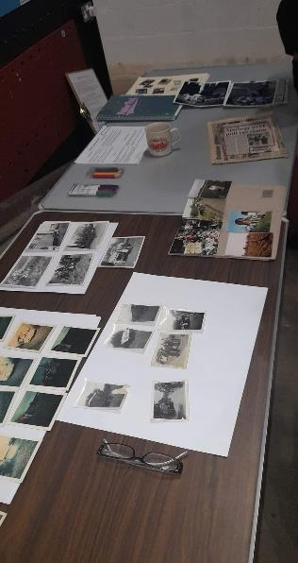
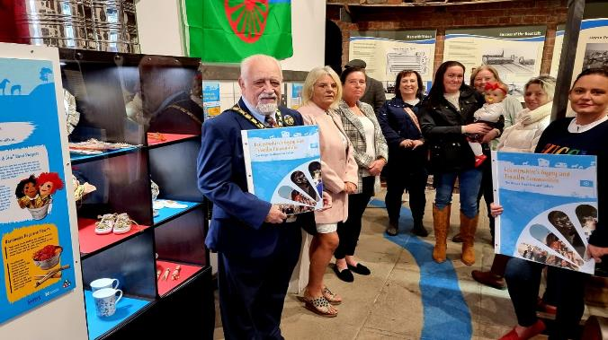
Home is Where We Are
Where is Home?
The GRT community have a different concept of home to settled community. For them home is where they are, rather than a fixed place. Their culture is about moving around.

Slide 19
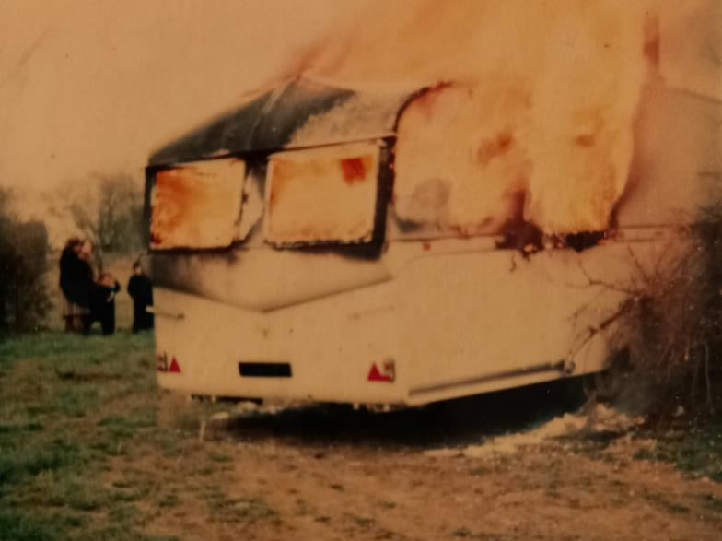
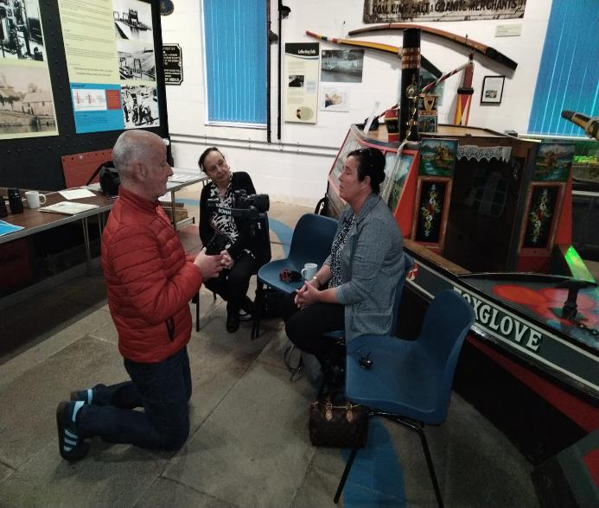
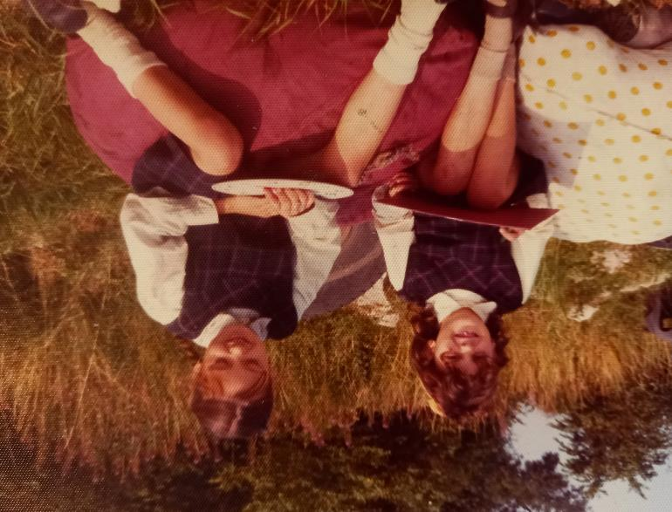
Home is Where We Are
What is Home?

Slide 20
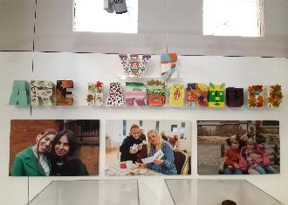
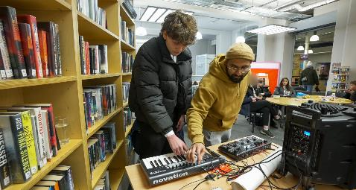
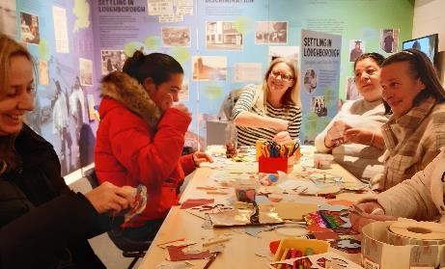
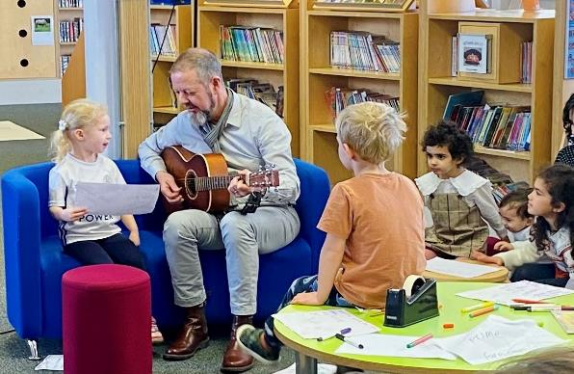
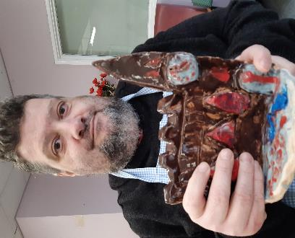
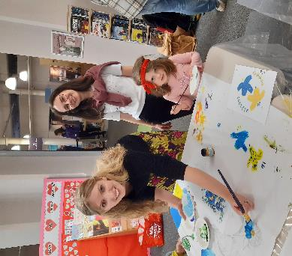
We Are Harborough
What makes a community?

Slide 21
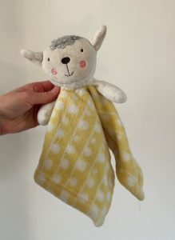
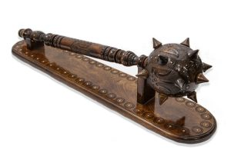
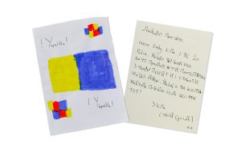
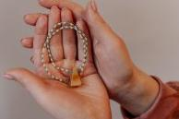
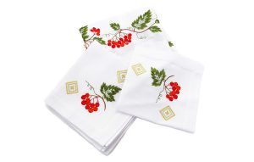
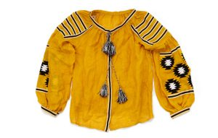
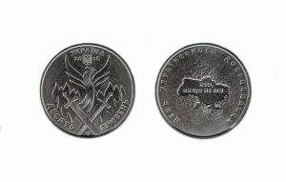
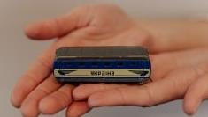
We Are Harborough
Our objects tell our story

Slide 22
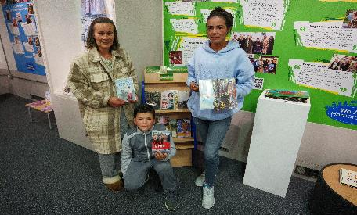
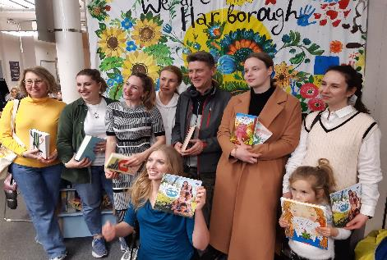
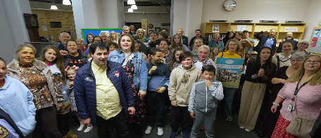
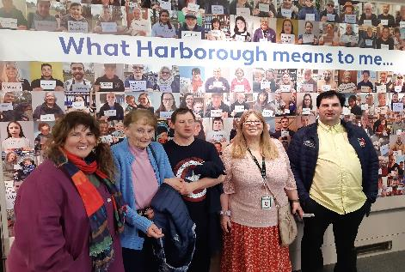
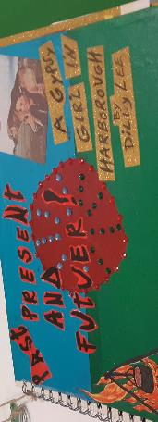
We Are Harborough
Themes and Legacy
7 CPs commissioned, including 2 Ukrainian – 2 people now have jobs as result of project
LALS group ongoing work via volunteering team
Gypsy & Traveller involvement in next project and interest from other organisations in working with them.
Increased use of library/museum by young people

Slide 23
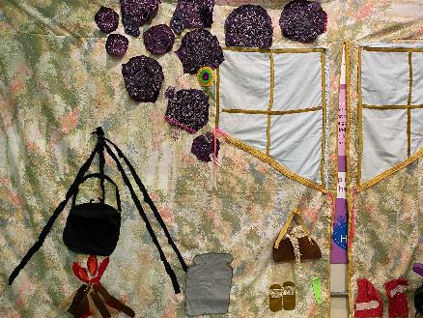
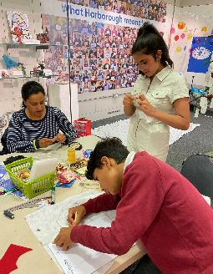
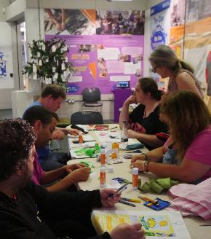
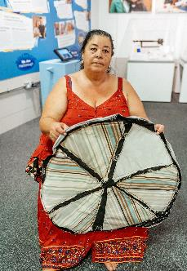
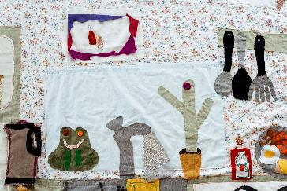
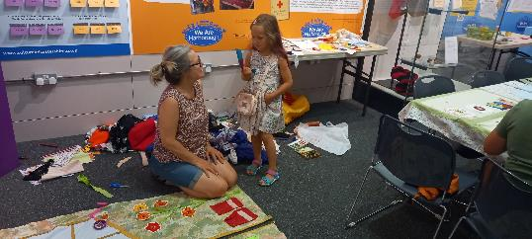
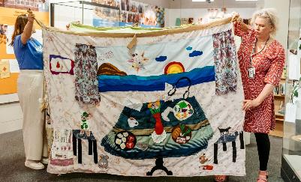
We Are Our Home
A Creative Response
Continue our work and maintain connection with new audiences
Embed their sense of place in the museum

Slide 24
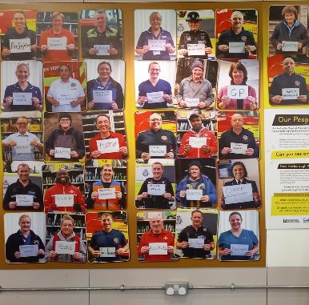
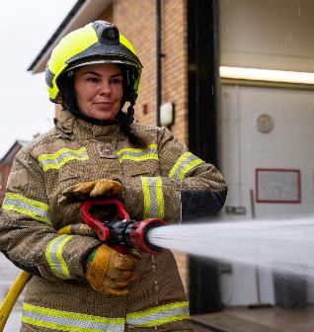
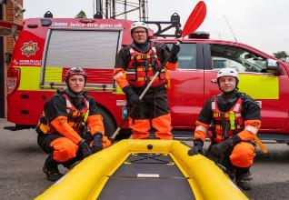
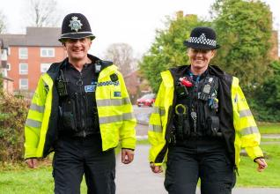
Harborough at Work
Reimagining Ladybird Books
Re-imagined Charnwood Museum exhibition to reflect Harborough to connect exhibition to the place it’s displayed
Community Connectors consulted for first time
Strong connection to place they work

Slide 25
Harborough at Work
A Creative Response
Focus on essence of work in Harborough
Cocuration through using the place as a starting point
Legacy display – 6 parts in different places in Harborough

Slide 26
84% say makes them feel more part of community
82% feel more connected to the venue
86% feel more connected to others

Slide 27
Creating a sense of place at Bosworth Battlefield Heritage Centre

Slide 37
… and gain a sense of …

Slide 38
Pride
Ownership
Commitment
Teamwork
Collaboration
Belonging
Achievement
Legacy
Impact
A sense of place

Slide 39
1620s House and Garden

Slide 40
1620s House and Garden Volunteers

Slide 41
DEFINE – UNDERSTAND - IMAGINE
Why?
Community Surveys
365 responses
Friends’ Welcome
The Friends Welcome – involving the Friends group, site staff and volunteers. Providing weekly games, crafting, activities and soup.
Volunteer are integral to this achievement
Put learned models from 2021 into good use
Bring new visitors to the site
Culture Changes Lives

Slide 42
Activities
Volunteers involved in delivering sessions
Wellbeing
Recruited a wellbeing expert to provide advice, guidance and information.
Vegetables for the soup are from the garden that the volunteers tend
Free hot drinks and soup
MAKING A DIFFERENCE

Slide 43
MODEL – EVALUATE - PRODUCE

Slide 44
Visitors said: “It has given me purpose. I am less isolated it has given me confidence to engage further with people outside of the group.”
Staff said:
“Understanding about the need, experience of the area, compassionate and passionate personalities and commitment to excellence is what the volunteers of Friends Welcome bring to this opportunity. It could not happen without them”
Volunteers said
“I feel proud to be part of the team that makes this happen. Knowing I can make a difference to people who live in my neighbourhood I know are struggling makes me happy.”

Slide 45
Reflection
Make space for new stories
Co-create with respect
There is no 1 ‘Sense of Place’
You can’t be everything to all people
Use research
Make clever partnerships
Flex your volunteering model
Ensure accessibility

Slide 46
Amanda. Hanton@leics.gov.uk – Cultural Participation Team Manager
Nicola.Levin@leics.gov.uk – Cultural Development Manager
Esther.Shaw@leics.gov.uk – Community Participation Worker
Helen.Murray@leics.gov.uk – Community Participation Worker
Pippa.VidalDavies@leics.gov.uk – Culture Leics Volunteering Manager
Alison.Clague@leics.gov.uk – Senior Curator
Catherine.Rogers@leics.gov.uk – Economic Growth Manager, Strategic Tourism Lead & Creative Leicestershire Lead
https://www.cultureleicestershire.co.uk
www.facebook.com/CultureLeics www.instagram.com/cultureleics

